Slide 1
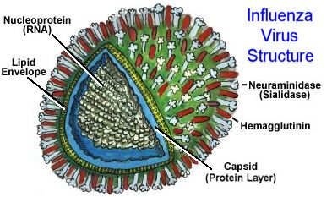
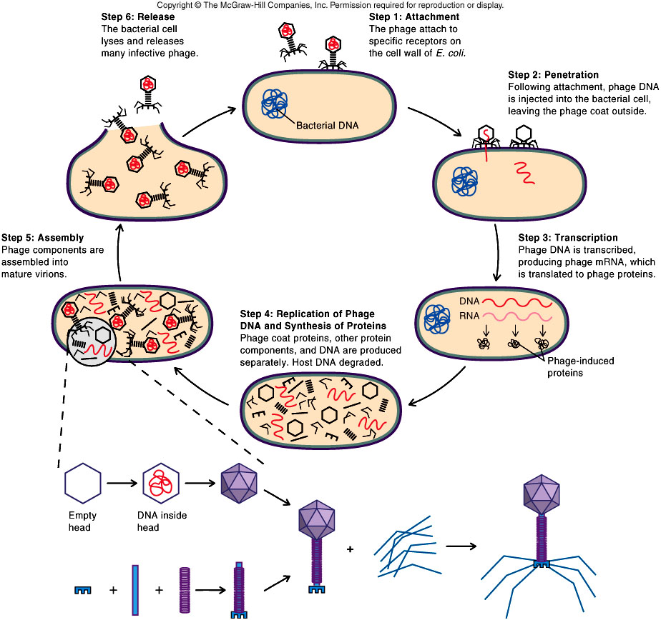
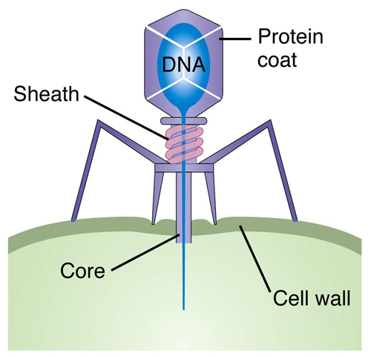
VIRUSES

Slide 2
What is a Virus?
A virus is a piece of genetic material (DNA or RNA) surrounded by a protective protein coat, called a capsid.
The capsid helps to protect the virus from being destroyed by the hosts immune system
Capsid

Slide 3
Viruses come in a variety of shapes
They are NOT considered to be a living thing.

Slide 4
Why are viruses considered non-living?
No cell structures, like cytoplasm, organelles or cell membranes
No cellular respiration
They cannot reproduce on their own

Slide 5
How does a virus reproduce?
Viruses have a Lytic Cycle. This means it destroys its host’s cell when they reproduce.
ATTACHMENT – The virus attaches itself to a host cell, to a specific receptor site on the cell membrane.
ENTRY – The virus enters the cell. This can happen in 2 ways:
Only the DNA/RNA is injected into the host cell (ex: T4 virus)
The whole virus enters, through Receptor-mediated endocytosis

Slide 6
3. REPLICATION –The host cell’s metabolism replicates (copies) the viral DNA/ RNA
4. ASSEMBLY - New virus particles are assembled inside the host cell
5. LYSIS AND RELEASE - The host cell breaks (lyses) open releasing the new virus particles
http://www.courses.fas.harvard.edu/~biotext/animations/lyticcycle.html

Slide 7
Lytic Cycle Diagram
DRAW DIAGRAM IN NOTES: Page 123, figure 4.21 in textbook

Slide 8
T4 Virus infecting a bacteria
http://www.youtube.com/watch?v=41aqxcxsX2w&feature=BFa&list=PL998C063DCABF2E7E&safety_mode=true&persist_safety_mode=1&safe=active
Flu Attack! How A Virus Invades Your Body
http://www.youtube.com/watch?v=Rpj0emEGShQ&feature=related&safety_mode=true&persist_safety_mode=1&safe=active

Slide 9
Questions
DRAW CYCLE IN NOTES: Page 123, figure 4.21
2. Why must a virus enter a host cell in order to reproduce itself?
3. A doctor tells a patient that an antibiotic will not help cure a cold sore. Explain the doctors reasoning.

