Slide 1
Kingdom Bacteria

Slide 2
For each of the FIVE kingdoms we need to know the following information:
Cell type
Nutrition
Body form
Reproduction
Locomotion
Examples

Slide 3
Cell type
Is it a prokaryotic or eukaryotic cell?
Prokaryotic cell – does NOT have a nucleus
Eukaryotic cell – has a nucleus

Slide 4
Nutrition
How does this organism get nutrients?
Autotroph – makes its own food
Heterotroph – does NOT make its own food, must get nutrients from another source

Slide 5
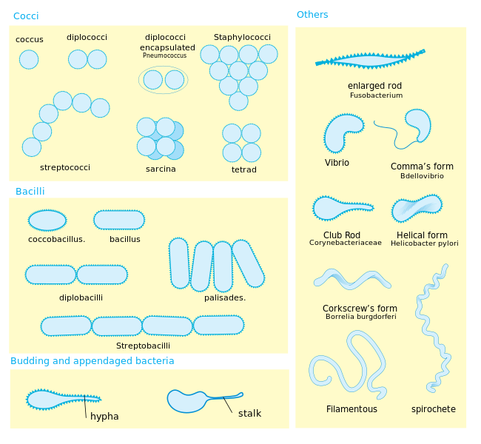
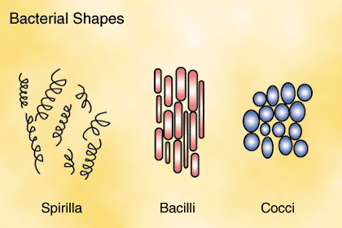
Body Form
Does this organism have a distinct body form?

Slide 6
Reproduction
How does the organism reproduce?
Asexual reproduction – only one parent. Offspring are identical.
Sexual – two parents involved. Offspring are NOT identical

Slide 7
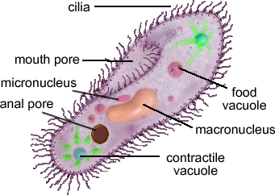
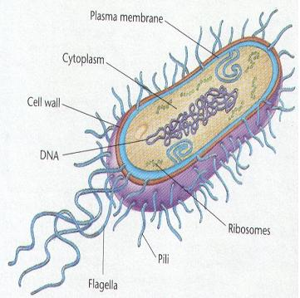
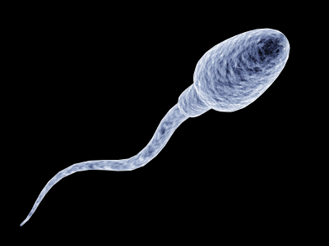
Locomotion
Can/how does the organism move?
Cilia – small hair-like projections
Flagella – larger, whip-like structure (tail)

Slide 8
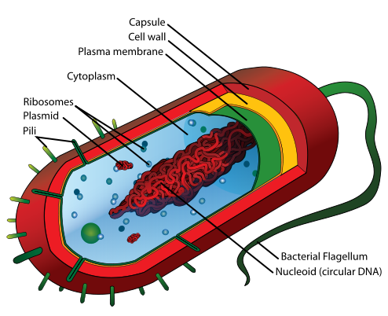
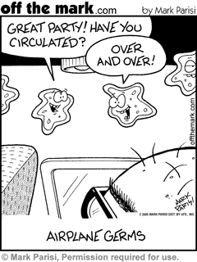
Kingdom Bacteria
Cell type: simple, prokaryotic organisms.

Slide 9
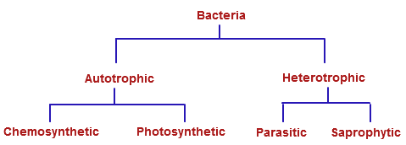
Nutrition:

Slide 10
Body type: They have different shaped bodies and are classified according to shape:

Slide 11
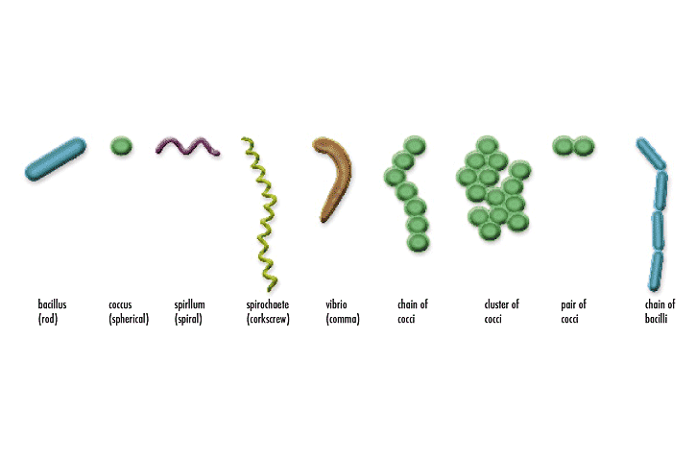

Slide 12
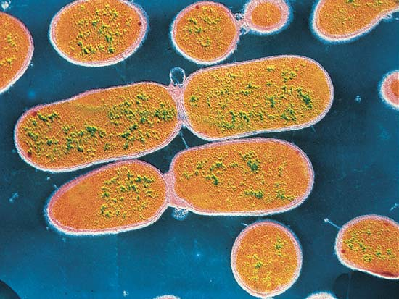
Reproduction: They can do Asexual or Sexual reproduction, depending on the situation. They prefer to do asexual reproduction because it is much faster, but if the environment changes, they must start doing sexual reproduction to adjust to the environment.

Slide 13
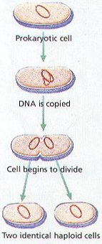
Asexual reproduction - one parental cell gives rise to 2 or more identical offspring. This is called binary fission in bacterial cells.
(p. 134 - 135)

Slide 14
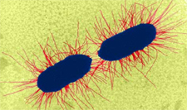
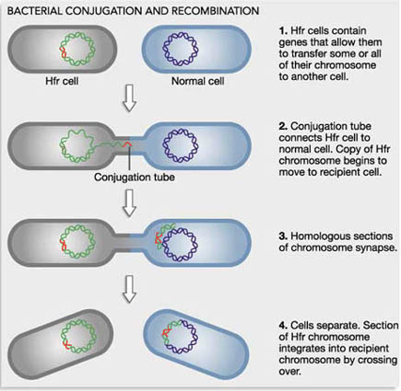
Sexual reproduction – two parents make one offspring that is NOT identical to either parent. This is called conjugation.

Slide 15
Steps to Binary Fission
1. Parent cell gets bigger and makes a copy of its DNA
2. The cell elongates and the two pieces of DNA move to opposite ends of the cell
3. A septum forms between the two pieces of DNA.
4. It separates and two new daughter cells are made
http://www.classzone.com/books/hs/ca/sc/bio_07/animated_biology/bio_ch05_0149_ab_fission.html

Slide 16
Steps to Conjugation
1. Two parent cells begin to form a pilus
2. DNA is exchanged between parent cells
3. The result is a daughter cell with genetically different DNA

Slide 17
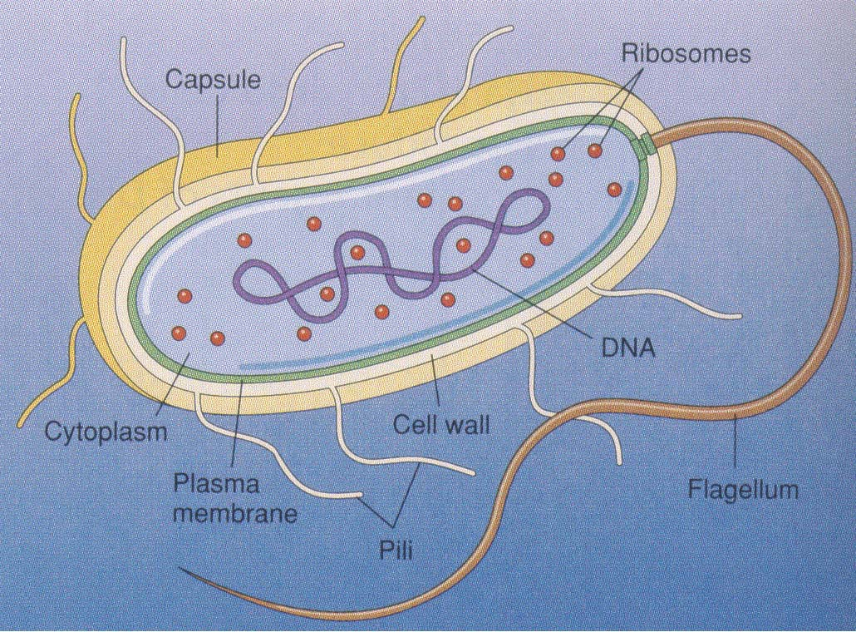
Locomotion:
1. flagella
2. pili

Slide 18
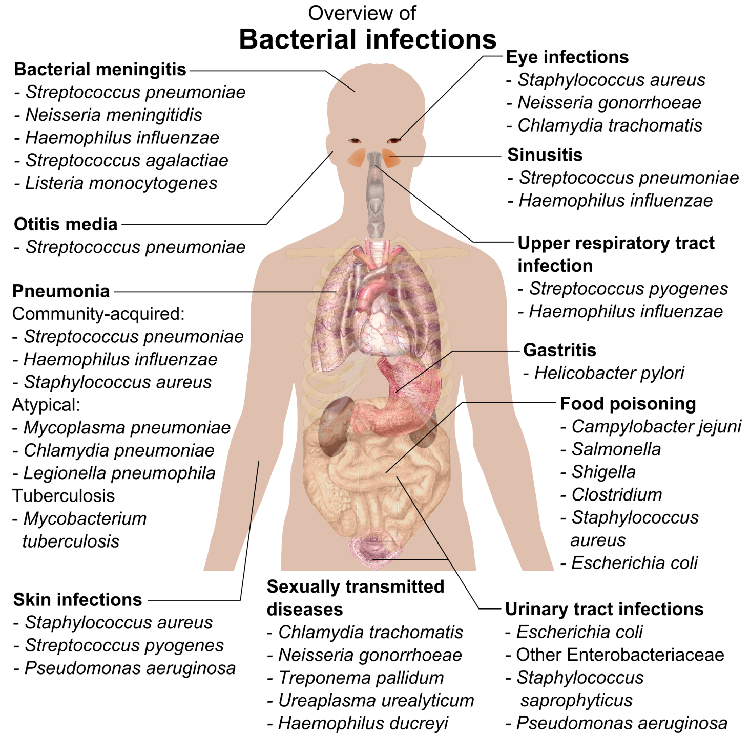
Examples:

